Slide 1
Motivation/context
Overview including human relation
???
Inverse perspective mapping (Camera lens distortion correction)
Road surface detection
Probabilistic histogram
Local orientation
Hough
Feature matching
Probabilistic Model matching
Optical flow
Confirmed by model matching
Path curve matching
Bezier curve path modelling

Slide 2
Put in a fun little bit here

Slide 3
Original scope
Intersection detection from still image
Restrictions
No other vehicles
Detectable road surface
Extension
Driving line confirmation and intersection tracking

Slide 4
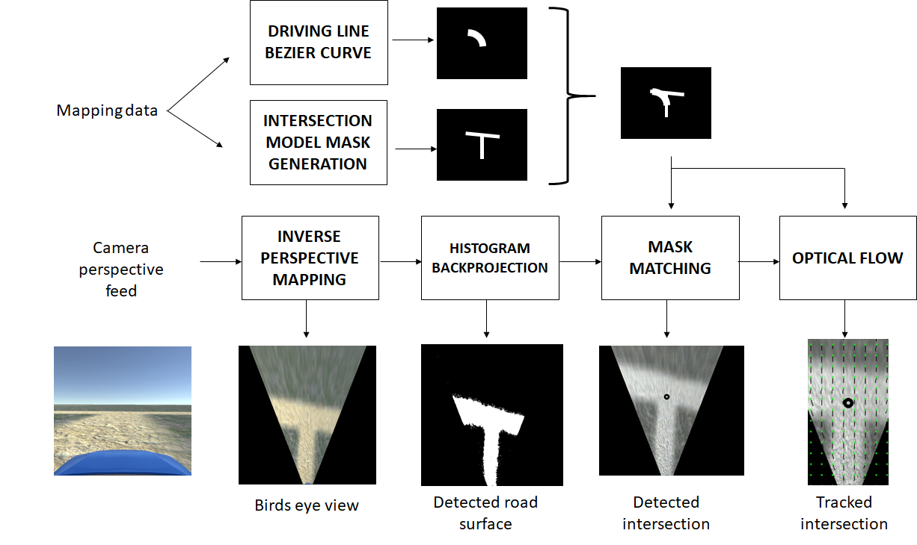

Slide 5





Mask Matching
$$M$$
$$I_{original}$$
$$I_{masked}$$
Hadamard product
$$I_{masked}=M∘I_{original}$$

Slide 8
IPM

Slide 9
IPM

Slide 10
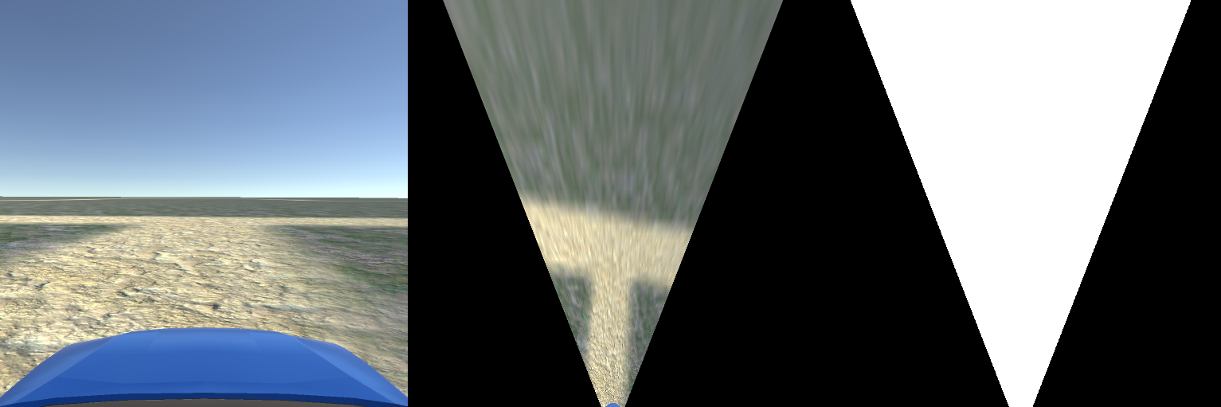
IPM
5m
5m
100px

Slide 13
Histogram Backprojection
IPM with box

Slide 16
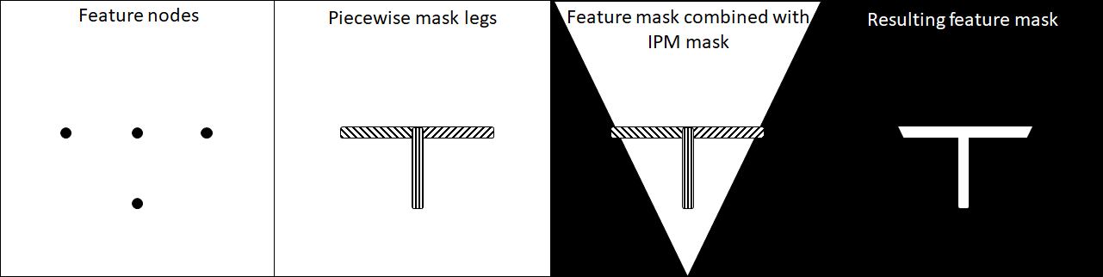
Feature mask generation

Slide 19
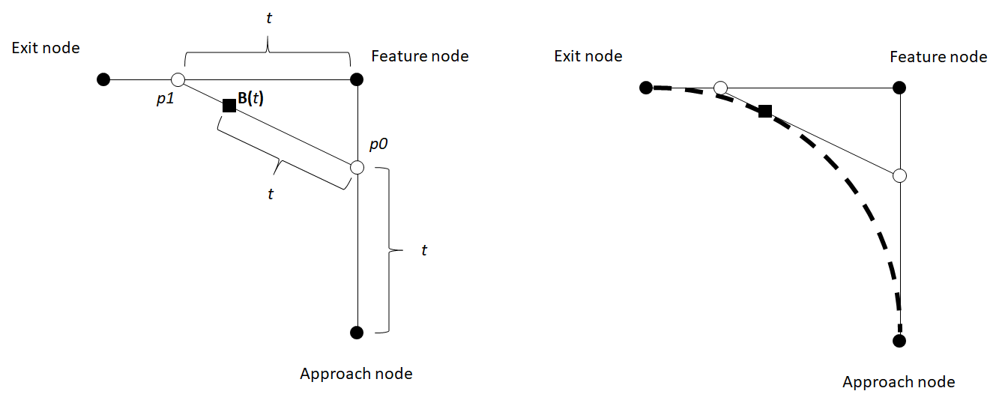
Driving line generation

Slide 23
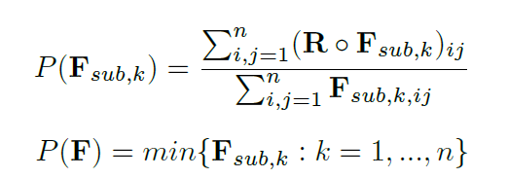


Mask Matching
Detected road
Feature mask

Slide 24
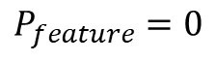
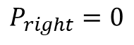
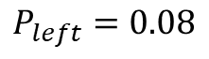
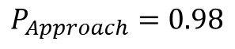
Mask Matching
$$P_{Approach}=0.98$$
$$P_{left}=0.08$$
$$P_{feature}=0$$
$$P_{right}=0$$

Slide 25

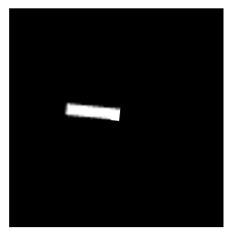
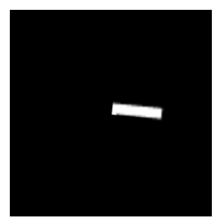
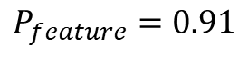
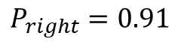
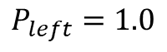
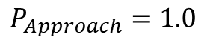
Mask Matching
$$P_{Approach}=1.0$$
$$P_{left}=1.0$$
$$P_{feature}=0.91$$
$$P_{right}=0.91$$

Slide 28
Optical flow
(2,3)

Slide 29
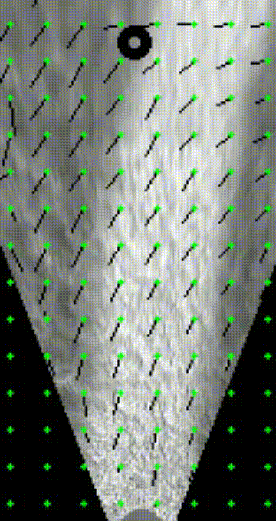
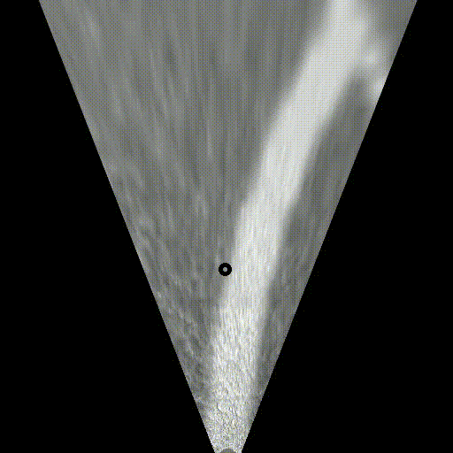
Optical flow

Slide 31
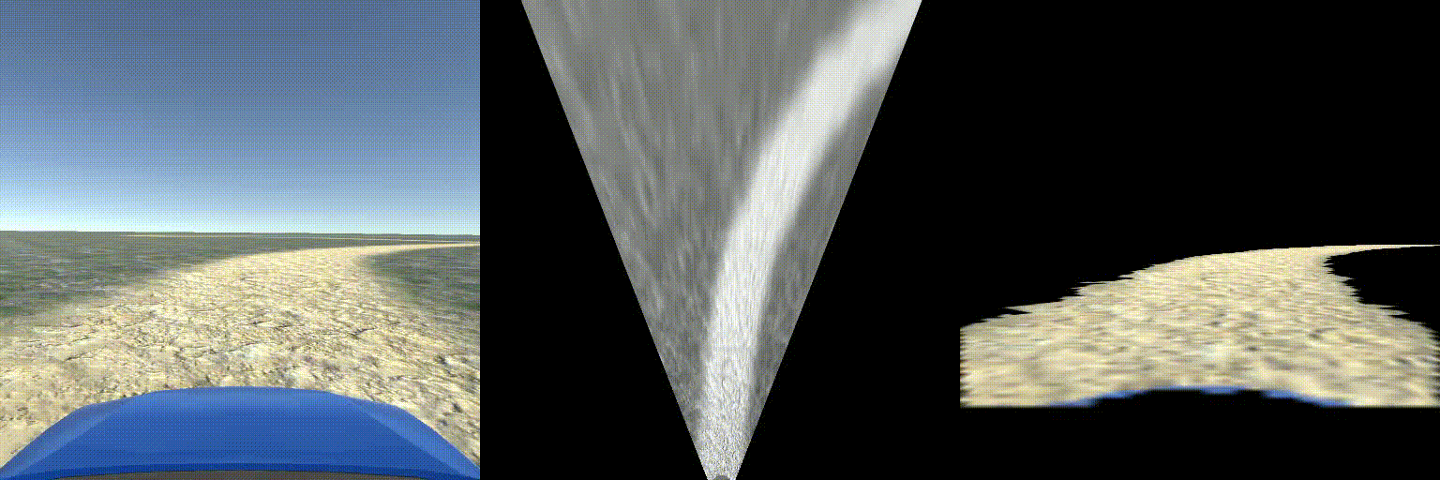

Slide 32
QUESTIONS

Slide 33
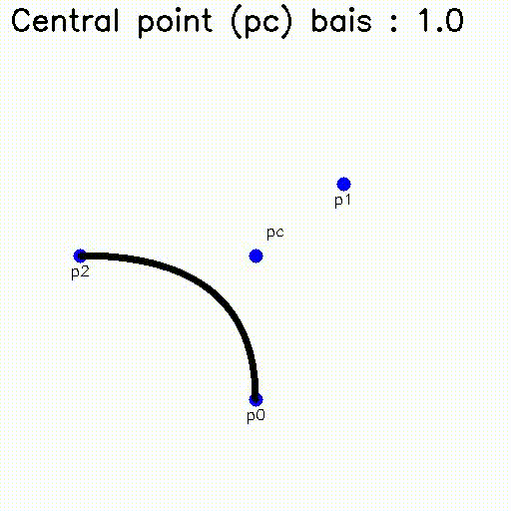
Path matching
Bezier curve theory
Interpolation between central point as p1 vs pc

Slide 34
Optical flow
Two-Frame Motion Estimation Based on Polynomial Expansion
Gunnar Farnebäck
http://www.diva-portal.org/smash/get/diva2:273847/FULLTEXT01.pdf

Slide 35
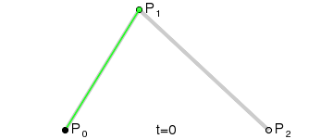
Bezier Curves

